Slide 1

Offline HTML5 Map Application
Jack Wearn

Slide 2


What is the project being undertaken?
Offline HTML5 Map Application
Displaying Open Street Map data for a niche market:
Areas of Outstanding Natural Beauty (AONB)
Technologies being used:
HTML5
CSS
JavaScript
Leaflet JS
Mapbox
Service Worker (For offline application)

Slide 3

What has been achieved so far?
Reports completed:
Web development in HTML5
Offline web application
Open Street Map data
Interim Report
Proof-of-Concept Programs:
Drawing shapes with HTML5 Canvas
Hello World application using application cache
Hello World application using service worker
To-do list application using IndexedDB
Loading OSM data
First Term Demo

Slide 4

Demo Application

Slide 5
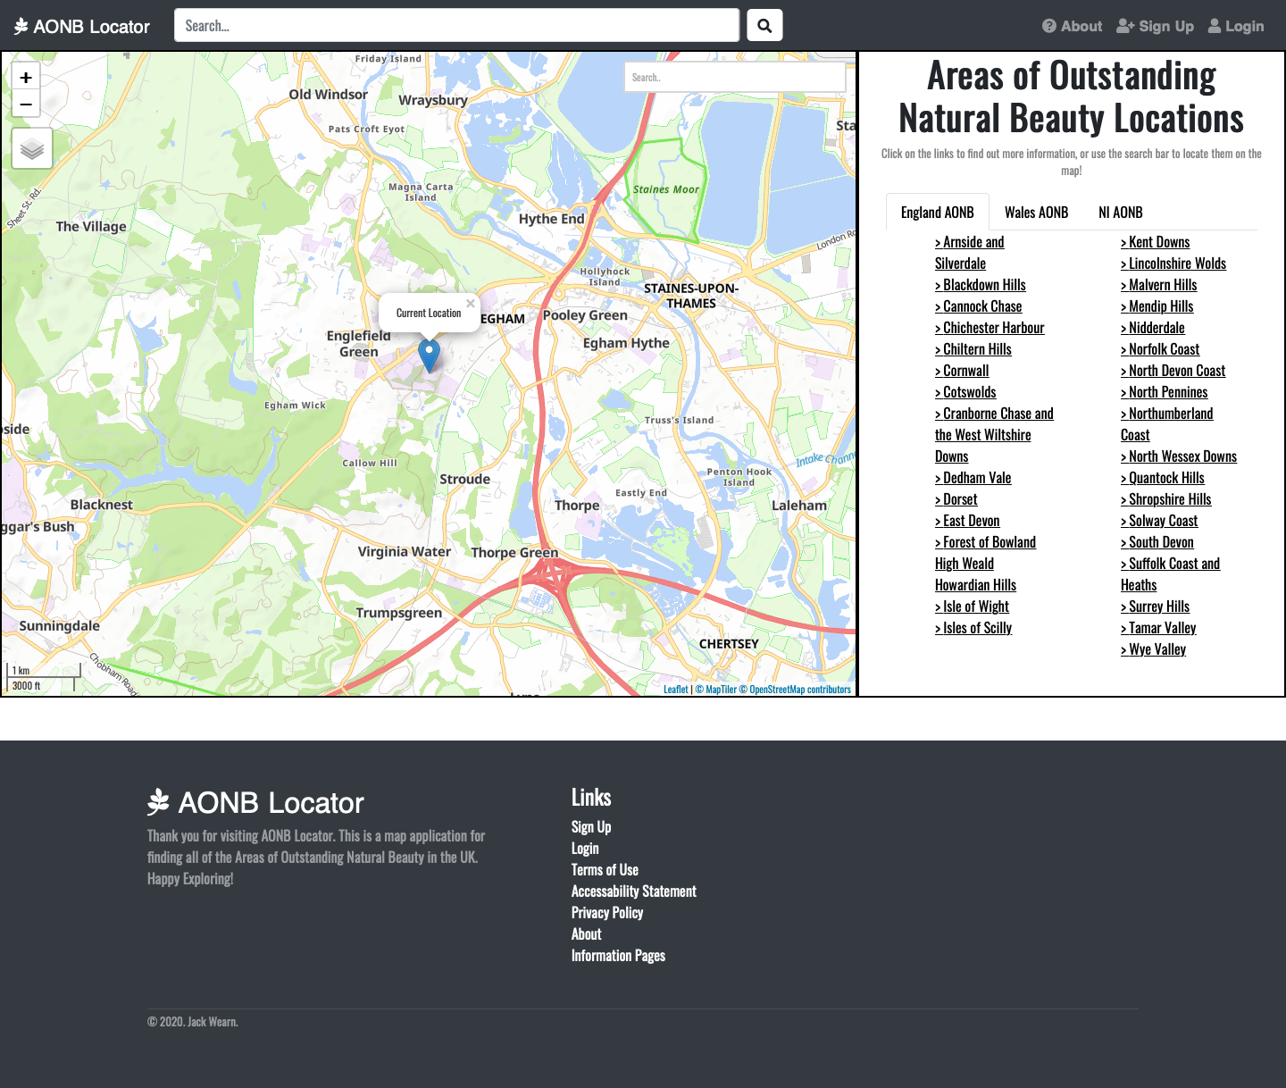
index.html
¾ Screen interactive map:
Custom search bar
Current location service
Tabs on right hand side:
Change between different UK locations
Select an AONB -> go to information page
Top-nav:
Links to other pages
About page, sign up & login page
Custom footer

Slide 6
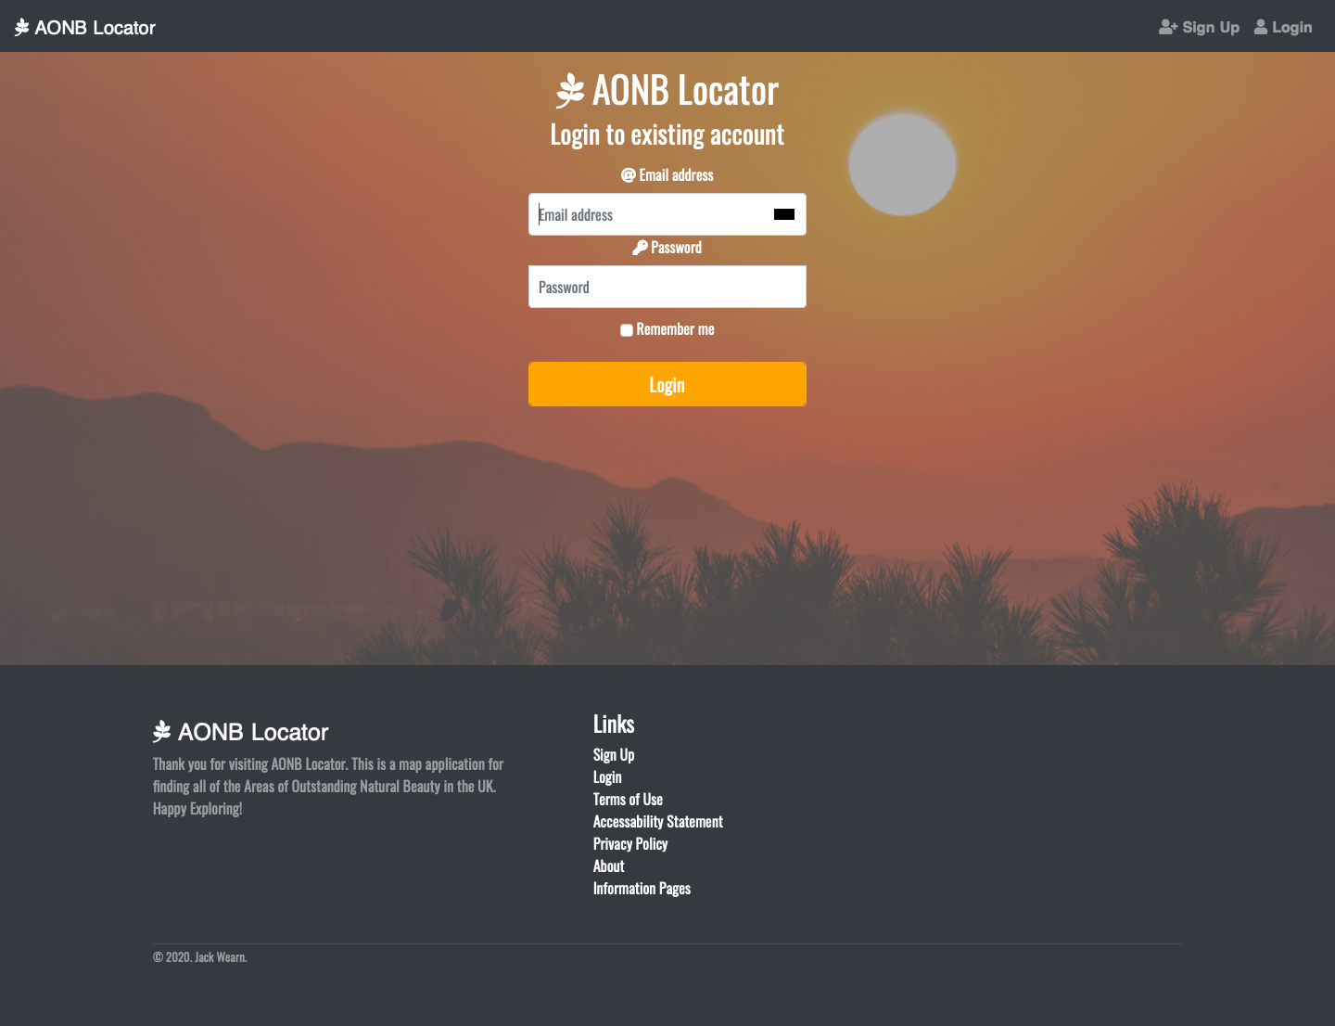
Signup.html & Login.html

Slide 7
Template.html (Template Information Page)
Static map displaying AONB
Will have the location highlighted more clearly
Have information on right hand side
Webpage design consistent

Slide 8

What I intend to achieve next
Get more features on the map working:
Navigation/route mapping
Better design of the locations rather than just points on the map
Working signup/login:
User able to upload own photos of areas
Save routes
Save locations they like
Better optimization of offline application:
User able to download portions of the map
Download routes for offline use

Slide 9
Thank you!
Questions?

